Slide 1
15-1 Double Integrals over Rectangles

Slide 2




Review of the Definite Integral
If f(x) is defined for a≦x≦b
Dividing the interval [a, b] into n subintervals [x_{i-1}, x_{i}] equal width △x= (b-a)/n
Choose sample points x_{i}* in these subintervals.
Then we form the Riemann sum
Take the limit of such sums as n→∞ to obtain the definite integral of f from a to b.

Slide 3
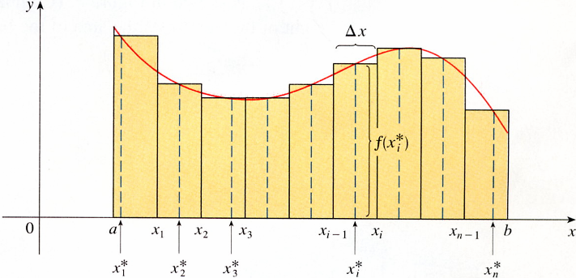

In the special case where f(x)≧0, the Riemann sum can be
f(x_{i}*)
X_{i}*
And f(x) dx represents the area under the curve y = f(x) from a to b.

Slide 4

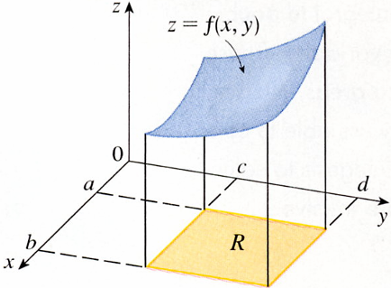
Volume and Double Integrals
We consider a function f of two variables defined on a closed rectangle.
R = [a, b] x [c, d]
= {(x, y) R²｜a≦x≦b, c≦y≦d}
Z
z = f(x, y)
First suppose that f(x, y) ≧0
f is a surface with equation z = f(x,y).
c
a
d
b
R
S be the solid
S = {(x,y,z) R³｜0≦z≦f(x, y), (x, y) R}

Slide 5
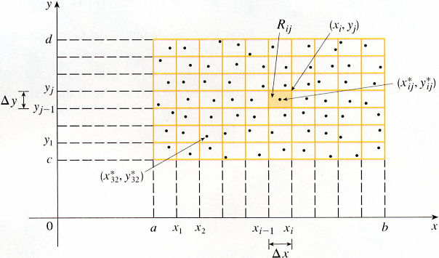
The first to divide the rectangle R into subrectangles
[a, b] into m subintervals [x_{i-1}, x_{i}], △x= (b- a)/m
[c, d] into n subintervals [y_{i-1}, y_{i}], △ｙ= (c- d)/n
R_{ij}
Sample point (x_{ij}*, y_{ij}*)
d
Dividing R into subrectangles
△y
△A = △x △y
c
R_{ij} = [x_{i-1}, x_{i}] X [y_{j-1}, y_{j}]
a
b
△x
= {(x, y)｜x_{i-1}≦x≦x_{i} , y_{j-1}≦y≦y_{j}}

Slide 6
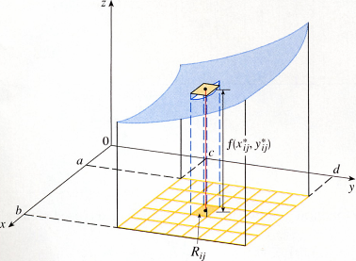
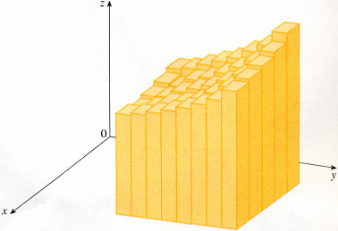
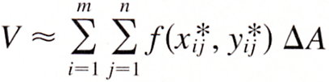



Choose a sample point (x_{ij}*, y_{ij}*) in each R_{ij}
z = f(x, y)
A thin rectangular box is
base R_{ij}(x_{ij}*, y_{ij}*)
height Z_{ij}= f(x_{ij}*, y_{ij}*)
f(x_{ij}*, y_{ij}*)
The volume of this box is
f(x_{ij}*, y_{ij}*)△A
R_{ij}(x_{ij}*, y_{ij}*)

Slide 7

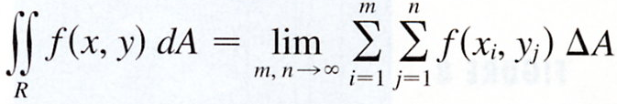

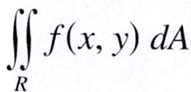
5 Definition
The double integral of f over the rectangle R is
if this limit exists.
Double Riemann sum
If f(x, y)≧0, then the volume V of the solid that lies above the rectangle R and below the surface z= f(x, y)
V =

Slide 8
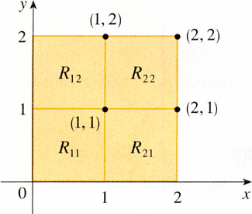


EXAMPLE 1 Estimate the volume of the solid that lies above the square R = [0, 2]X[0, 2] and below the elliptic paraboloid z= 16- x²- 2y². Divide R into four equal squares and choose the sample point to be the upper right corner of each square R_{ij}. Sketch the solid and the approximating rectangular
boxes.
SOLUTION
(1, 2)
(2, 2)
The squares are shown the area of each square △A= 1. m= n= 2
R₁₂
R₂₂
z=f(x_{i}, y_{i})= 16- x²- 2y²
(1, 1)
(2, 1)
By the Riemann sum
R₁₁
R₂₁

Slide 9
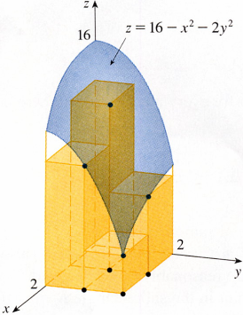
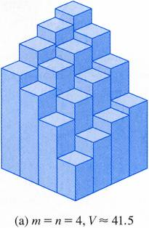
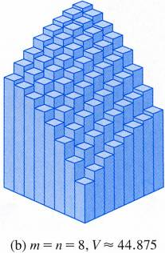
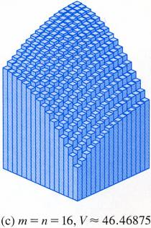

This is the volume of the approximating rectangular boxes
m=n=2
m=n=4, V≒41.5
m=n=8, V≒44.875
m=n=16, V≒46.46875

Slide 10

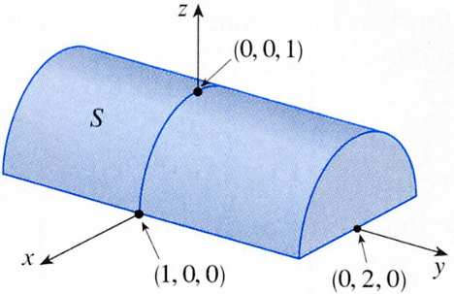


EXAMPLE 2 If R = {(x,y)｜-1≦x≦1, -2≦y≦2}, evaluate the integral
SOLUTION
Because z = 1- x² ≧0
z² = 1-x²
z² + x²= 1

Slide 11

The Midpoint Rule
This means that we use a double Riemann sum to approximate the double integral, the sample point (x_{ij}*, y_{ij}*) in R_{ij} is
chosen to be the center (x_{i}, y_{j}) of R_{ij}.
x_{i} is the midpoint of [x_{i-1}, x_{i}]
y_{i} is the midpoint of [y_{j-1}, y_{j}]

Slide 12



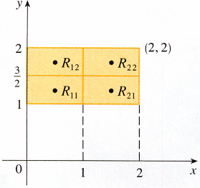

EXAMPLE 3 Use the Midpoint Rule with m=n=2 to estimate the value of the integral , where R={(x,y)｜0≦x≦2, 1≦y≦2}
SOLUTION
y
(2, 2)
2
y₂
3/2
f(x, y) = x- 3y²
y₁
1
x₁ =1/2, x₂= 3/2, y₁= 5/4, y₂= 7/4
0
X₁
2
X₂
1
x
= -11.875

Slide 13
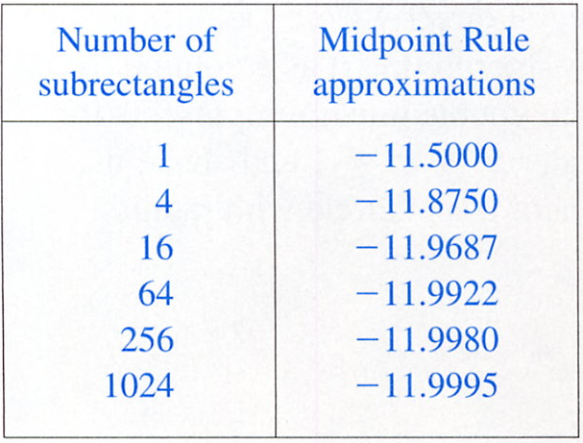

Slide 14


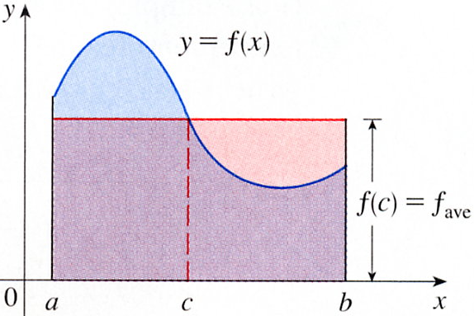
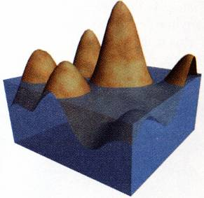

Average Value
Recall from Section 6.5
Two variables defined on a rectangle R to be
(Where A(R) is the area of R)
If f(x,y)≧0,
Says that the box with base R and height f_{ave} has the same volume as the solid that lies under the graph of f.

Slide 15
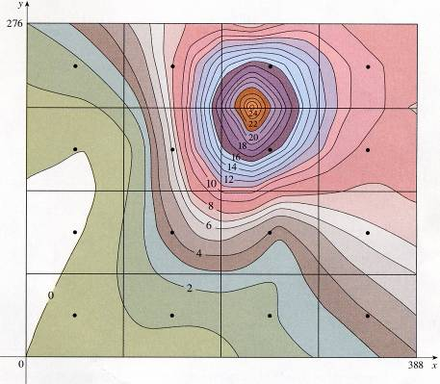
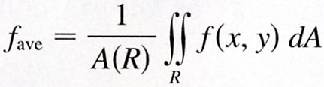
EXAMPLE 4 The contour map in Figure 12 shows the snowfall, in inches, that fell on the state of Colorado on December 24, 1982. (The state is in the shape of a rectangle that measures 388 mi west to east and 276 mi south to north.) Use the contour map to estimate the average snowfall for Colorado as a whole on December 24.
y
SOLUTION
276
0≦x≦388, 0≦y≦276
f(x, y) is the snowfall
A(R) = 388‧276
△A
x
Midpoint Rule with m=n=4
388
△A = (388)(276)/16 = 6693 mi²

Slide 16
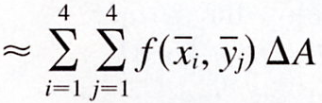
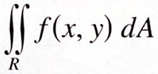


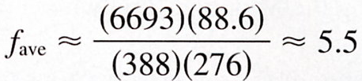
y
276
x
388

Slide 17




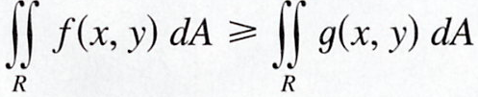

Properties of Double Integrals
Assume that all of the integrals exist.
If f(x, y)≧g(x, y) for all (x, y) in R, then

Slide 18
15-1 Exercises
EX12，EX13

